Slide 1



Convolutional Neural Networks
Mohsen Ghafoorian
Jan 10, 2017
Materials partly taken from
Stanford’s Convolutional Neural Networks for Visual Recognition course

Slide 2
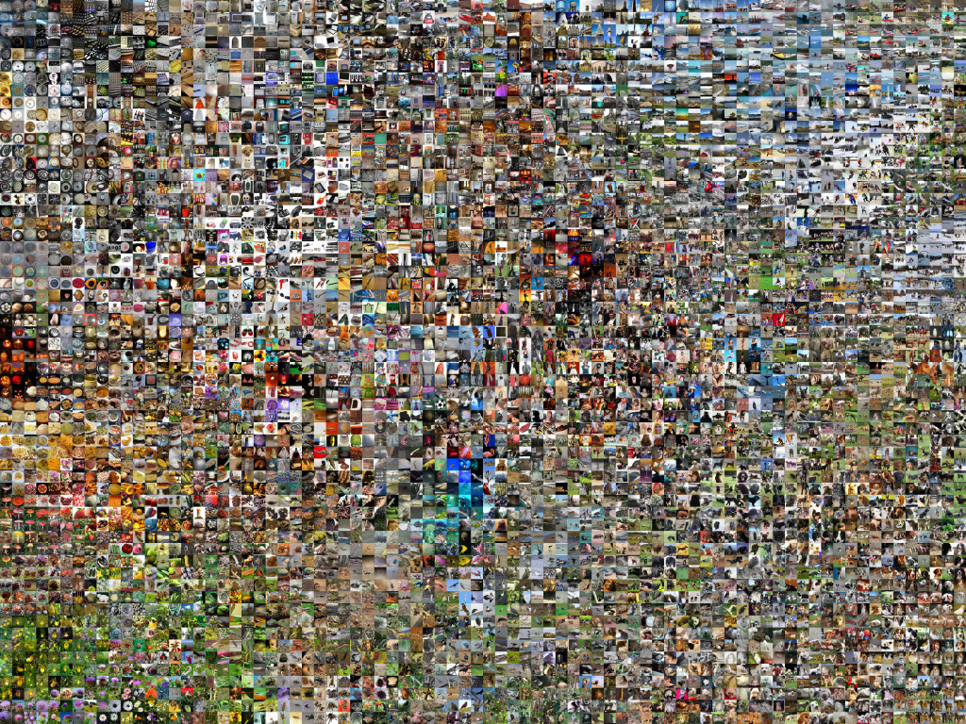


1,000 image categories
1,431,167 images

Slide 3


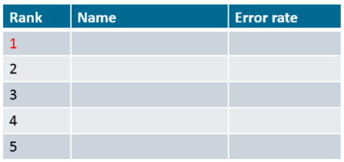
2010: 28%
2011: 26%
2012:
U. Toronto 16%
U. Tokyo 26%
U. Oxford 27%
INRIA 27%
U. Amsterdam 29%
2013: All the 20 first ranking methods were using deep learning!!

Slide 4
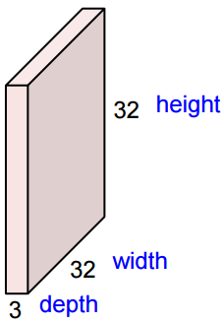

Convolutional Neural Nets
32x32x3 image
5x5x3 filter

Slide 5
Convolutional Neural Nets
32x32x3 image
5x5x3 filter

Slide 6
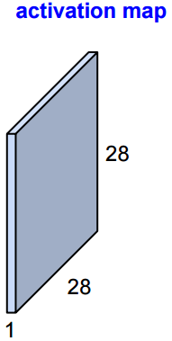
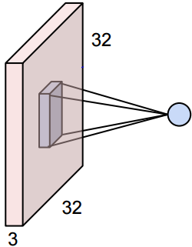
Convolutional Neural Nets
Sum over 5x5x3 = 75 multiplications

Slide 7
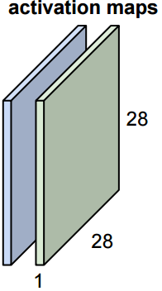
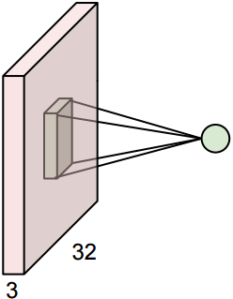
Convolutional Neural Nets
Now consider a second green filter

Slide 8
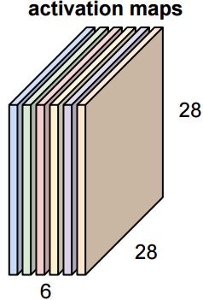
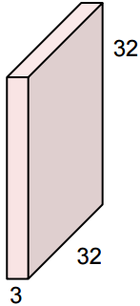
Convolutional Neural Nets
Assuming we had six 5x5 filters:
Convolutional Filter
Image: $(x, y, d)$
$k$ filter: $(m, n, d)$
?
Activation map: $(x−m+1, y−n+1, k)$

Slide 9
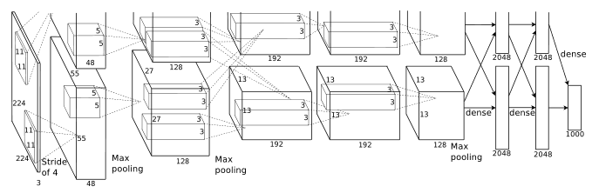
Alex Net
[Krizhevsky et al. 2012]
Winner of Imagenet 2012
by a large margin!
[224x224x3] INPUT
[55x55x96] CONV1: 96 11x11 filters, stride:4
[27x27x96] MAX POOL1: 3x3 filters stride 2
[27x27x96] NORM1
[27x27x256] CONV2: 256 5x5 filters, stride 2, pad 2
[13x13x256] MAX POOL2: 3x3 filters, stride 2
[13x13x256] NORM2
[13x13x384] CONV3: 384 3x3 filters stride 1, pad 1
[13x13x384] CONV4: 384 3x3 filters stride 1, pad 1
[13x13x256] CONV5: 256 3x3 filters stride 1, pad 1
[6x6x256] MAX POOL3: 3x3 filters stride 2
[4096] FC6: 4096 neurons
[4096] FC7: 4096 neurons
[1000] FC8: 1000 neurons (class scores)

Slide 10
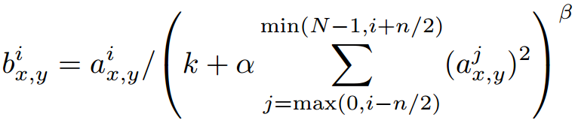
Alex Net
[Krizhevsky et al. 2012]
Details:
First use of ReLU
Used Normalization layers across adjacent kernels activations (not common anymore)
Heavy data augmentation (with a factor > 2048)
Dropout 0.5
Batch size 128
SGD momentum 0.9
Learning rate 0.01, reduced by factor of 10 when val accuracy plateaus
L2 Weight decay 0.0005
7 CNN ensembles 18.2% => 15.4%

Slide 11
Alex Net
[Krizhevsky et al. 2012]
CONV1: (11x11x3)x96 = 34,848
CONV2: (5x5x96)x256 = 614,400
CONV3: (3x3x256)x384 = 884,736
CONV4: (3x3x384)x384 = 1,327,104
CONV5: (3x3x384)x256 = 884,736
FC6: (6x6x256)x4096 = 37,748,736
FC7: 4096x4096 = 16,777,216
FC9: 4096x10 = 40,960
58,312,736 $≈$60 M

Slide 12
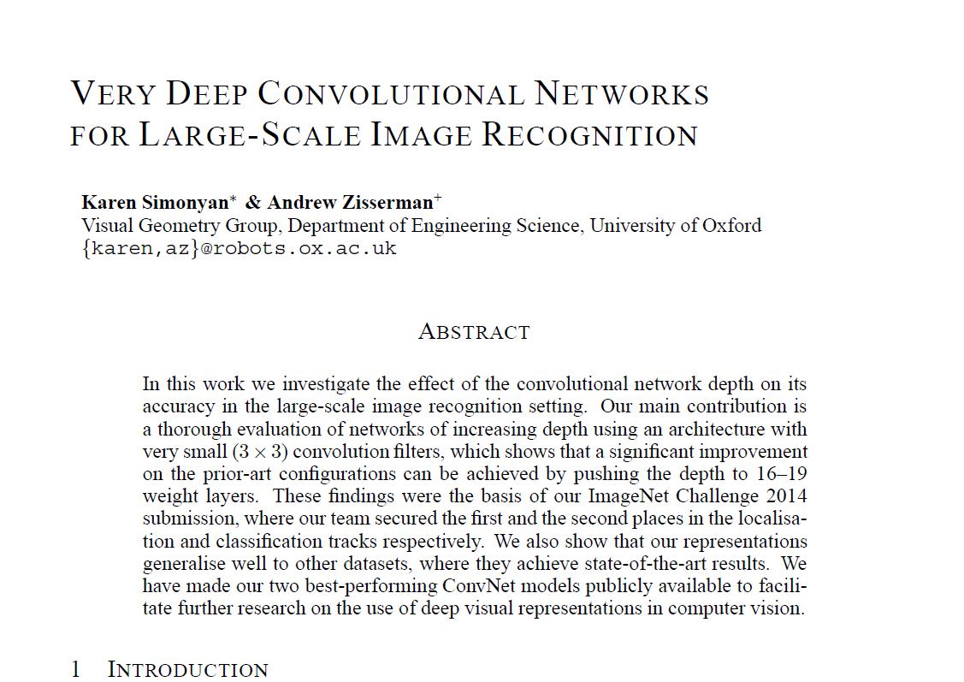
VGG Net (Oxford Net)
[Simonyan and Zisserman 2014]

Slide 13
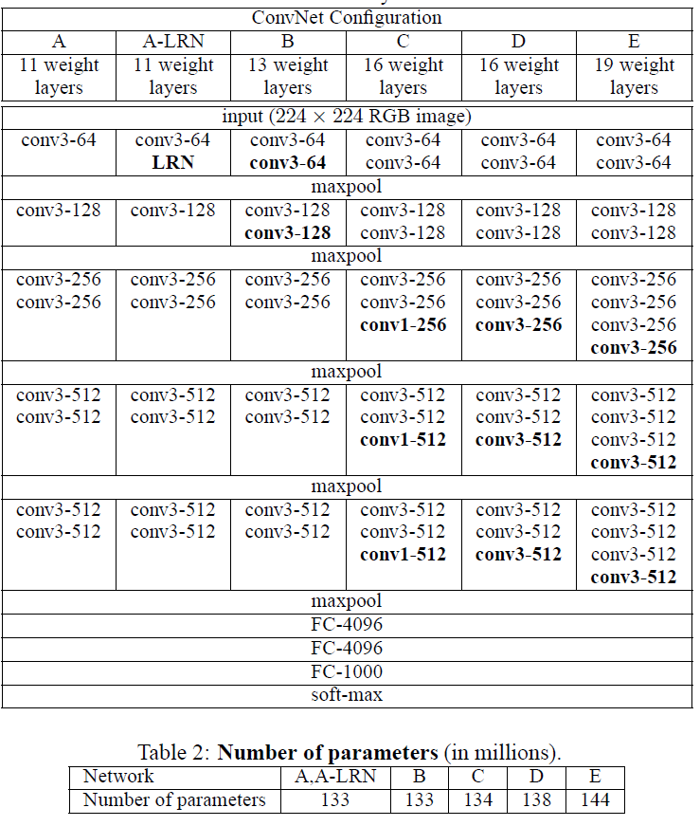
VGG Net (Oxford Net)
[Simonyan and Zisserman 2014]
Runner-up of Imagenet 2014
7.3% top-5 error rate!
Main idea:
Fix the filter size: 3x3
Fix the pooling 2x2 stride 2
Go deeper!
Best model

Slide 14
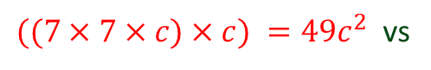
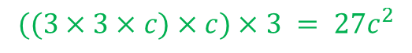
VGG Net (Oxford Net)
[Simonyan and Zisserman 2014]
Why 3x3 convolutions??
1. Getting rid of a filter-size as a hyper-parameters
Keep adding layers until they help!
2. Similar receptive field, less parameters, more nonlinearities!
Comparison of a layer of 7x7 vs. 3 layers of 3x3
$((7×7×c)×c) =49c^{2}$ vs
$$((3×3×c)×c)×3 = 27c^{2}$$
1 nonlinearity applied vs. 3 nonlinearities
7
5
5
7

Slide 15
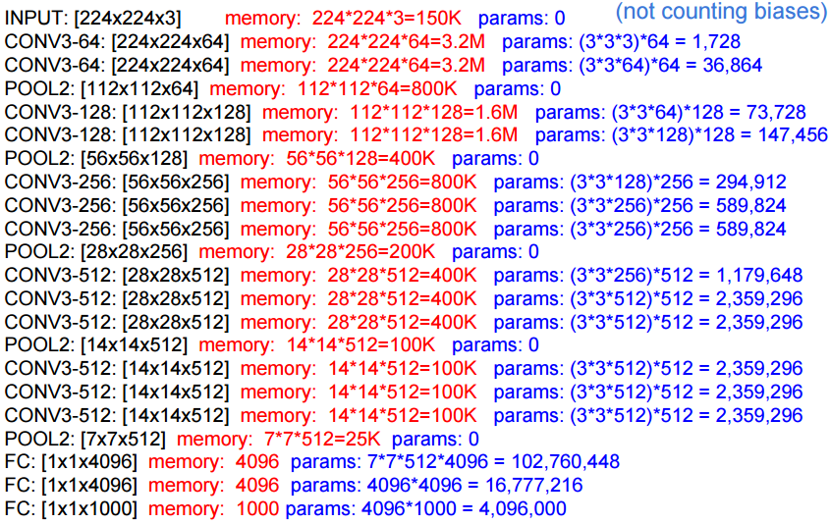
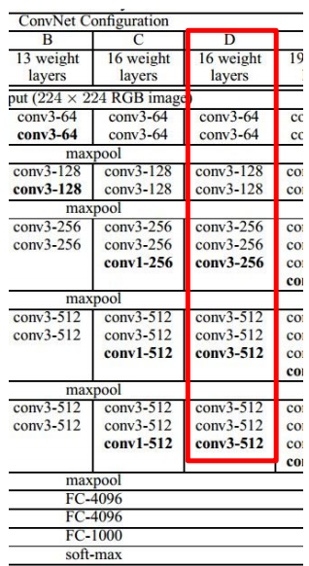
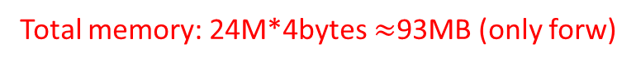
VGG Net (Oxford Net)
[Simonyan and Zisserman 2014]
Total memory: 24M*4bytes $≈$93MB (only forw)
Layer with
the most
number of
parameters
Question: what is your recommended
Minibatch size with 4GB memory?

Slide 16
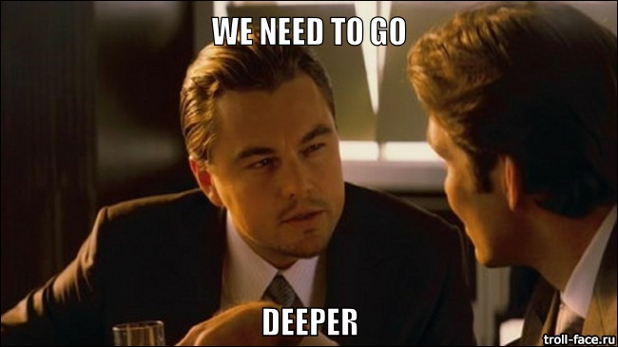
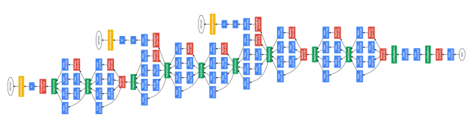
GoogLeNet
[Szegedy et al. 2014]
“Going deeper with convolutions”
Inception network
22 layers network
6.7% Top-5 error rate!
Winners of Imagenet 2014

Slide 17
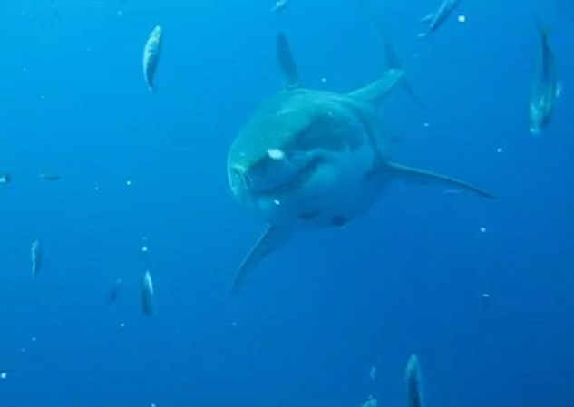
GoogLeNet
[Szegedy et al. 2014]
Big challenges for going deeper:
Increased number of parameters
Increased computational cost

Slide 18
GoogLeNet
[Szegedy et al. 2014]
Does it make any sense to do 1x1 convolutions?
Can we do dimensionality reduction on the depth?
1x1 conv

Slide 19
GoogLeNet
[Szegedy et al. 2014]
Which one?
Pick them all!!
1x1 conv?
3x3 conv?
5x5 conv?
Pooling?

Slide 20
GoogLeNet
[Szegedy et al. 2014]
Which one?
Pick them all!!
1x1 conv?
3x3 conv?
5x5 conv?
Pooling?

Slide 21
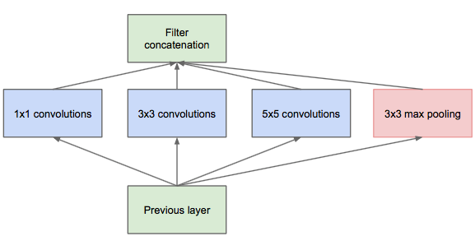
GoogLeNet
[Szegedy et al. 2014]
What to do?
Pick them all!!
1x1 conv?
3x3 conv?
5x5 conv?
Pooling?
Inception module (naïve version)

Slide 22
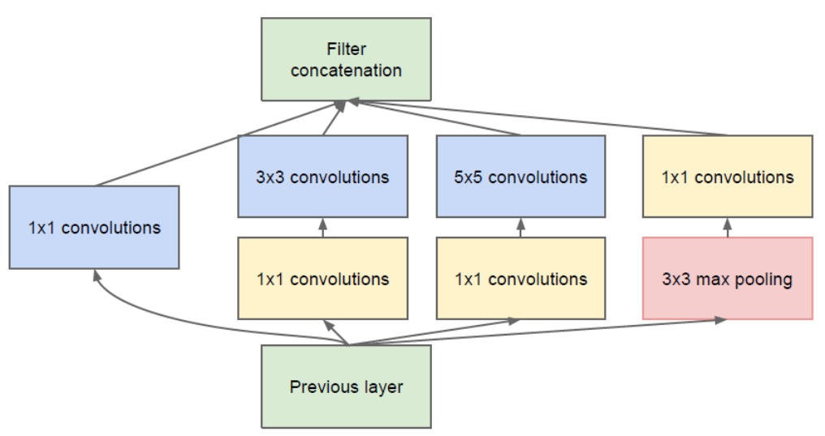
GoogLeNet
[Szegedy et al. 2014]
Inception module (naïve version)
Inception module with dimensionality reduction

Slide 23
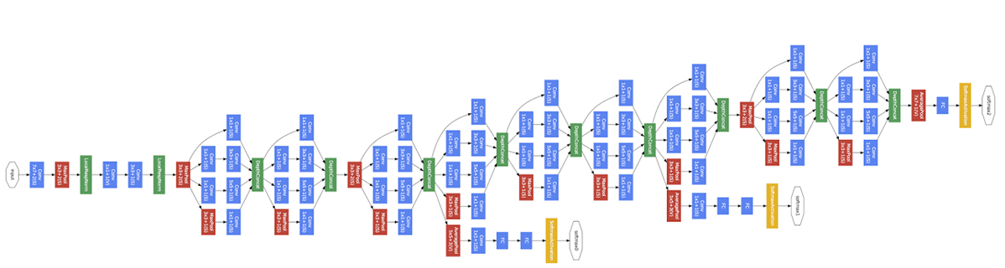
GoogLeNet
[Szegedy et al. 2014]
9 inception layers

Slide 24
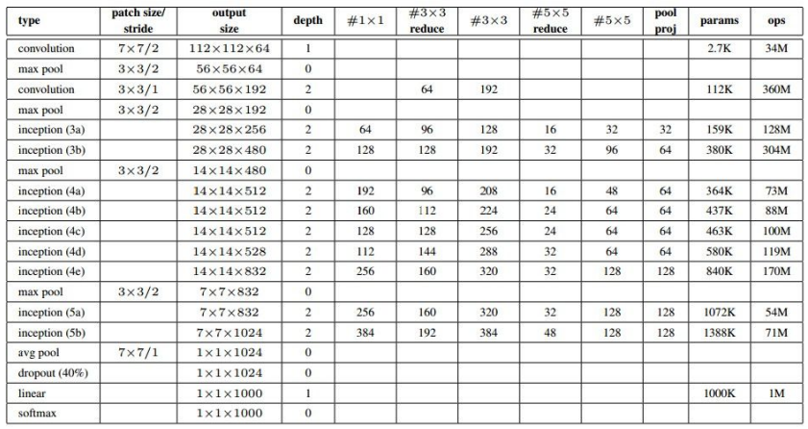
GoogLeNet
[Szegedy et al. 2014]
Only 5M parameters! (12x fewer than Alex net, 27x fewer than VGG net!)
How is it possible??!

Slide 25
VGG Net (Oxford Net)
[Simonyan and Zisserman 2014]

Slide 26
GoogLeNet
[Szegedy et al. 2014]
The key contribution is made by
average pooling instead of fully connected layers
Average pooling

Slide 27
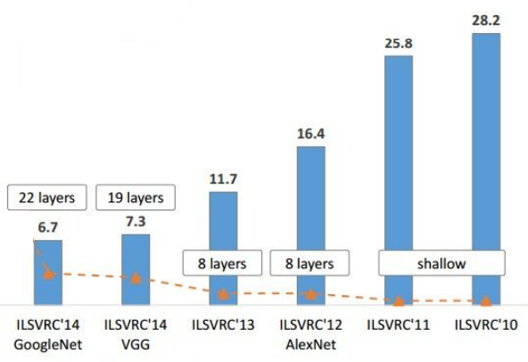
What’s next?
[Szegedy et al. 2014]

Slide 28
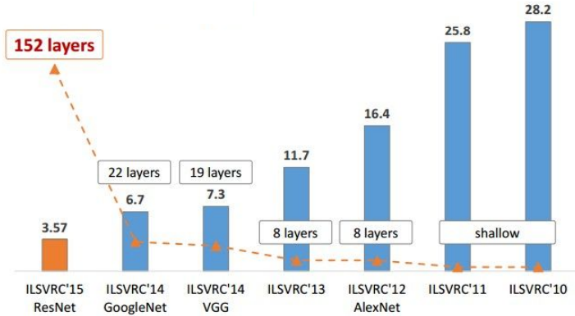
What’s next?
[Szegedy et al. 2014]

Slide 29
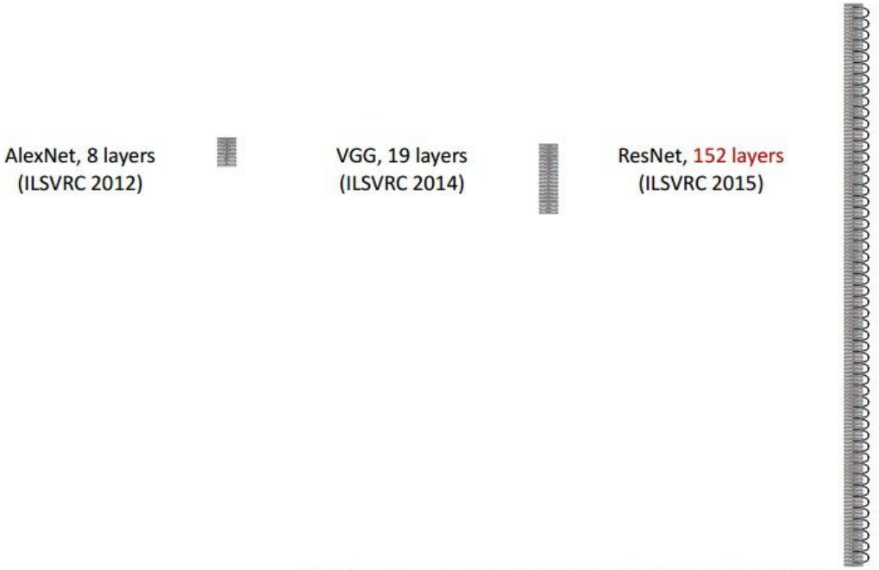
Residual Networks
[He et al. 2015]
Introduced “residual nets” against “plain nets”
Reached 3.57% top-5 error rate!!
Winners of ImageNet 2015 in all sub-competitions!

Slide 30
Residual Networks
[He et al. 2015]

Slide 31
Residual Networks
[He et al. 2015]
A shallow network
(18 layers)
A deeper counterpart
(34 layers)
“Degradation problem”: A deeper model should not have higher training error
Original layers: copied from shallower model
Extra layers: set as identity
At least the same training error
Therefore, “Solvers might have difficulties approximating identity mappings by multiple non-linear layers”

Slide 32
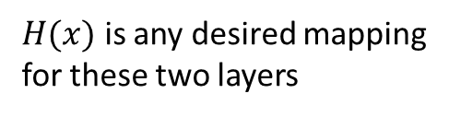
Residual Networks
[He et al. 2015]
Plain net
….
$H(x)$ is any desired mapping
for these two layers
….

Slide 33
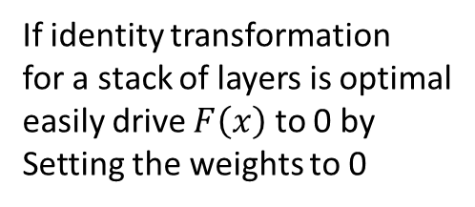
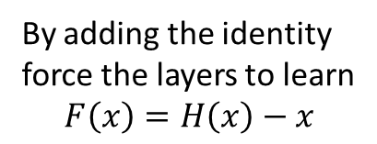
Residual Networks
[He et al. 2015]
Residual net
….
By adding the identity
force the layers to learn
$$F\left(x\right)=H\left(x\right)−x$$
If identity transformation
for a stack of layers is optimal
easily drive $F\left(x\right)$ to 0 by
Setting the weights to 0
….

Slide 34
Residual Networks
Basic design style (VGG style)
All 3x3 conv (almost)
No max pooling (almost)
No hidden FC
Batch normalization
No dropout

Slide 35
Residual Networks
Dealing with different dimensions:
(A) Zero padding (no extra parameters)
(B) Zero padding and 1x1 conv
(C) All 1x1 conv

Slide 36
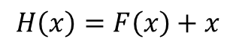
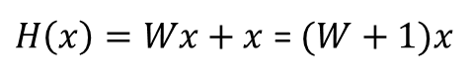
Residual Networks
[He et al. 2015]
How many layers to stack?
$$H\left(x\right)=F\left(x\right)+x$$
Single layer?
$H\left(x\right)=Wx+x$ = $(W+1)x$

Slide 37
Residual Networks
[He et al. 2015]

Slide 38
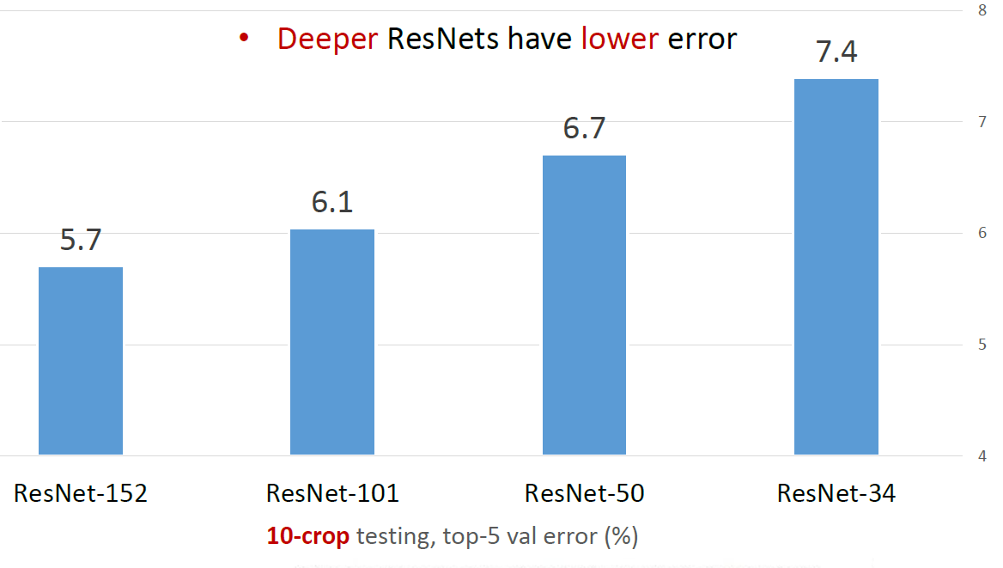
Residual Networks
[He et al. 2015]

Slide 39
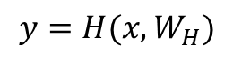
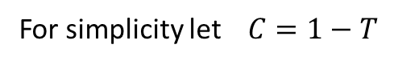
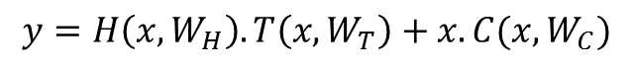
Highway Networks
[Srivastava et al. 2015]
“We refer to networks with this architecture as highway networks, since they allow unimpeded information flow across several layers on information highways”
$$y=H(x, W_{H})$$
$$y=H\left(x, W_{H}\right).T\left(x,W_{T}\right)+x.C(x,W_{C})$$
Transform gate
Carry gate
For simplicity let $C=1−T$
$$y=H\left(x, W_{H}\right).T\left(x,W_{T}\right)+x.(1−T\left(x,W_{T}\right))$$

Slide 40
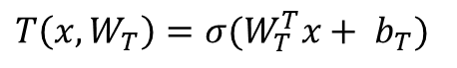
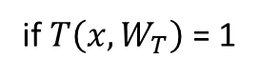
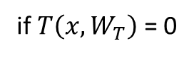
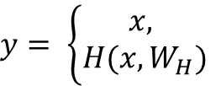
Highway Networks
[Srivastava et al. 2015]
“We refer to networks with this architecture as highway networks, since they allow unimpeded information flow across several layers on information highways”
$$y=H\left(x, W_{H}\right).T\left(x,W_{T}\right)+x.(1−T\left(x,W_{T}\right))$$
$$y= \left\{\begin{aligned}x, \\ H(x, W_{H})\end{aligned}\right.$$
if $T\left(x,W_{T}\right)$ = 0
if $T\left(x,W_{T}\right)$ = 1
To be learned via backpropagation
$T\left(x,W_{T}\right)=σ(W_{T}^{T}x+ b_{T})$
Initialize with negative value (e.g. -3)
to have an initial carry behavior
(inspired by the preferred LSTM initial bias in bridging)

Slide 41
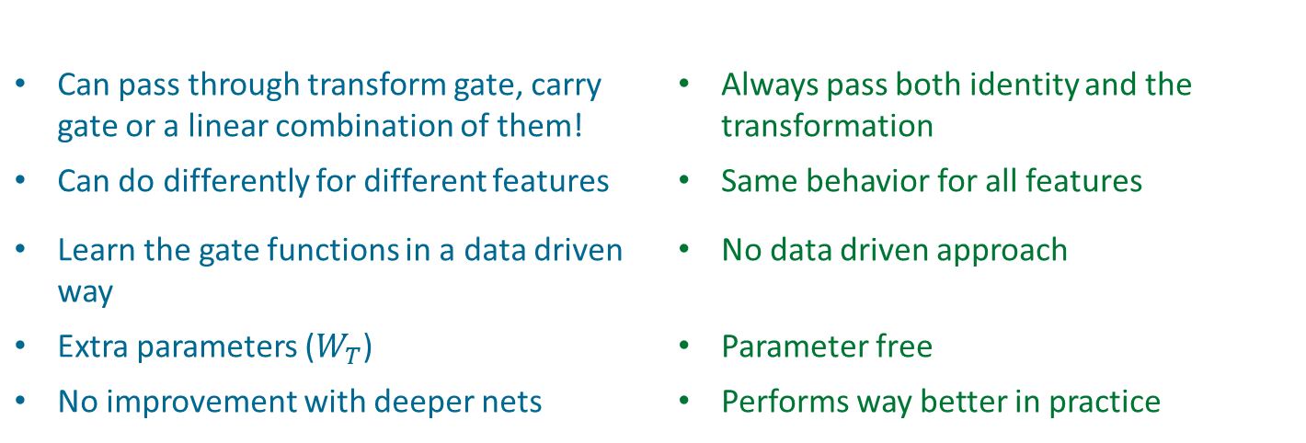
Highway vs. Residual Networks
[Srivastava et al. 2015]
Highway Nets
Residual Nets
$$y=H\left(x, W_{H}\right).T\left(x,W_{T}\right)+x.(1−T\left(x,W_{T}\right))$$
Can pass through transform gate, carry gate or a linear combination of them! | Always pass both identity and the transformation
Can do differently for different features | Same behavior for all features
Learn the gate functions in a data driven way | No data driven approach
Extra parameters ($W_{T}$) | Parameter free
No improvement with deeper nets | Performs way better in practice

Slide 42
Highway vs. Residual Networks (CIFAR)
Highway nets

Slide 43
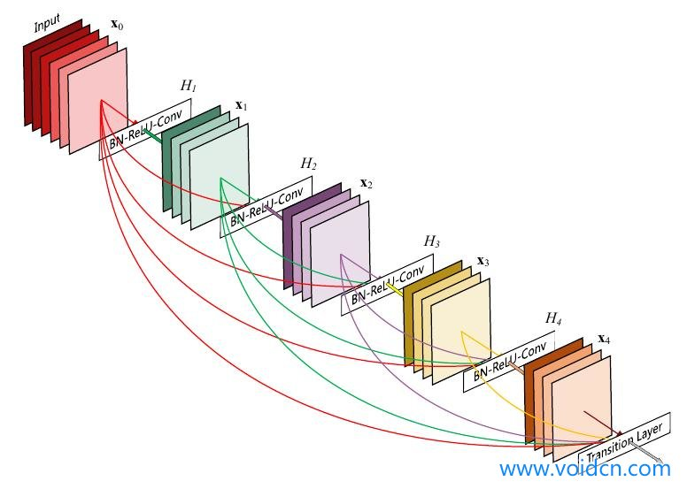
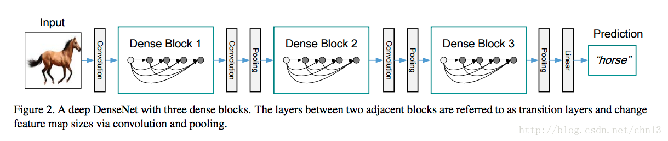
Densely connected Convolutional networks

Slide 44
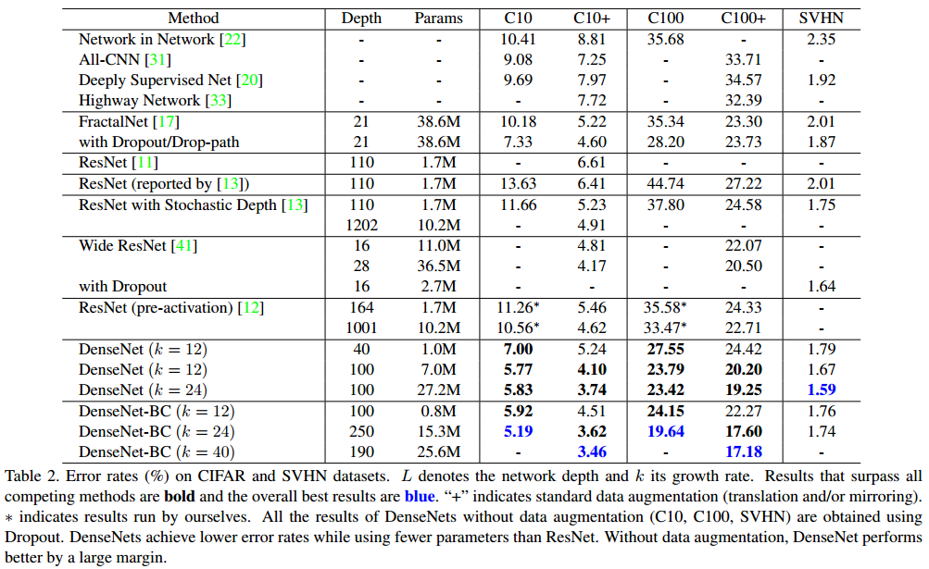
Densely connected Convolutional networks

Slide 45
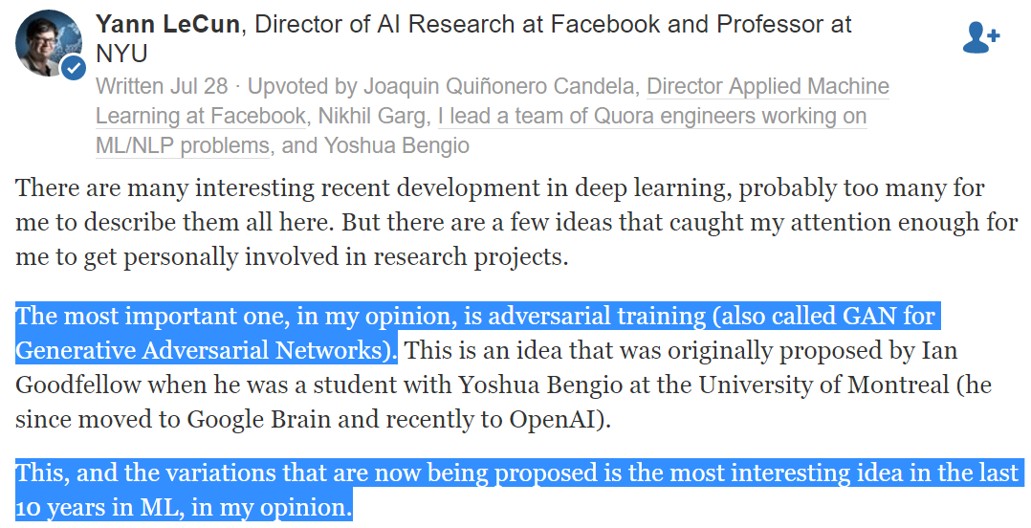
Generative Adversarial Networks

Slide 46
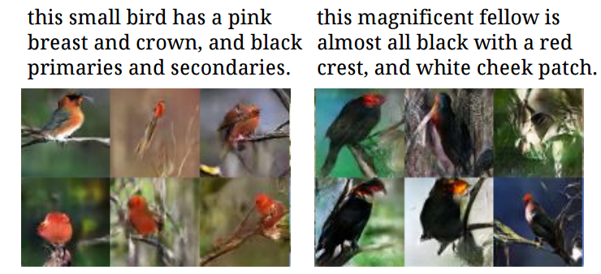
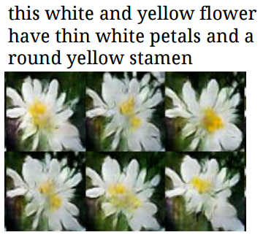
Generative Adversarial Text to Image Synthesis [Reed et al., 2016]

Slide 47
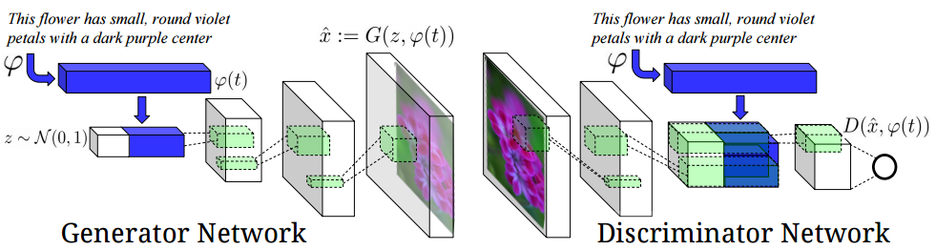
Generative Adversarial Text to Image Synthesis

Slide 48
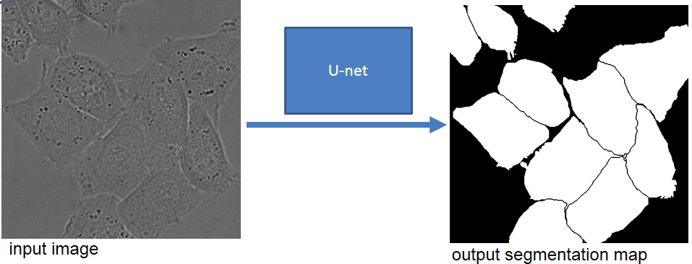
U-net
[Ronneberger et al. 2015]
Motivations:
Segmentation of images in an end-to-end setting
Few annotated images
Touching objects
Initial layers: fine info, lack context
Deeper layers: context info, lack details
Why not combining these
features?!

Slide 49

U-net
[Ronneberger et al. 2015]
Contraction path
Expansion path

Slide 50
U-net
[Ronneberger et al. 2015]

Slide 51

U-net
[Ronneberger et al. 2015]
Up convolutions:

Slide 52
U-net
[Ronneberger et al. 2015]

Slide 53

U-net
[Ronneberger et al. 2015]
Large images that do not fit on the memory?
Tile-based processing
Segmentation of yellow area uses input data of the blue area
Raw data extrapolation by mirroring

Slide 54


U-net
[Ronneberger et al. 2015]
Too few images?
Use augmentation with random elastic deformation.
Resulting deformed image
Correspondingly deformed labels

Slide 55

U-net
[Ronneberger et al. 2015]
Touching objects?
Penalize the misclassification of border regions higher!
Distance to
second closest
segment
Distance to
closest segment
Weight map to
balance the
class frequencies

Slide 56


U-net
[Ronneberger et al. 2015]
Results on ISBI 2015 cell tracking challenge:

Slide 57

Hey Baut, ask if
it has a favorite
color!

